Slide 1
MGMT 6055 Project Scope & Requirements
Lawrence Kinlin School of Business
Module 2
Notes:
Content for slides in this PPT file is drawn significantly from PMBOK, 6th edition, published by PMI (required text for this course)

Slide 2
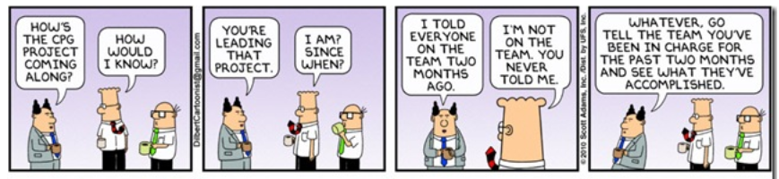
Notes:
Image Credit: http://www.function1.com/2015/06/why-project-onboarding-is-important

Slide 3
Learning Objectives
Projects and Project Management
Project Management Body of Knowledge (PMBOK), PMI
The Statement of Work (SOW)
The Project Charter

Slide 4
Definition of A Project
A temporary endeavor undertaken to create a unique product, service or result
Has a definite beginning and end
The project ends when the project objectives are achieved (or the project is terminated due to not achieving the project objectives)

Slide 5
Definition of A Project (cont’d)
Industries implement projects to produce deliverables for customers
E.g., aerospace, manufacturing, financial services, health, event planning, information technology)
Organizations also implement internal projects
E.g., opening a second location, implementing new organizational policies, undertaking a corporate merger or acquisition)

Slide 6
What is project management?
Project management is the discipline of planning, organizing, securing, managing, leading, and controlling resources to achieve specific goals.
From last module…

Slide 7
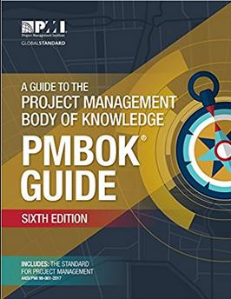

PMBOK GUIDE – The Key resource for this course
Most of the project management concepts in this course are described in the Project Management Body of Knowledge (PMBOK)
Project Management Body of Knowledge (PMBOK), published by the Project Management Institute (PMI – www.pmi.org)
We are using 6th edition in this course (free e-text link in FOL Content/Getting Started and in Welcome announcement on course home page)
Notes:
PMI Certifications:
Certified Associate in Project Management (CAPM)®
Project Management Professional (PMP)®
Program Management Professional (PgMP)®
PMI Agile Certified Practitioner (PMI-ACP)SM
PMI Risk Management Professional (PMI-RMP)®
PMI Scheduling Professional (PMI-SP)®

Slide 8
PMBOK GUIDE – The Key resource for this course
Contains knowledge, terminology, and practices that are applicable to most projects most of the time
Knowledge and practices in PMBOK are considered to be ‘good practice’ – will enhance project success
A reference book, not a step-by-step sequential ‘recipe book’
The most important resource for passing PMI exams to obtain PMI certifications such as PMP (Project Management Professional) or CAPM Certified Associate in Project Management)
Notes:
PMI Certifications:
Certified Associate in Project Management (CAPM)®
Project Management Professional (PMP)®
Program Management Professional (PgMP)®
PMI Agile Certified Practitioner (PMI-ACP)SM
PMI Risk Management Professional (PMI-RMP)®
PMI Scheduling Professional (PMI-SP)®

Slide 9
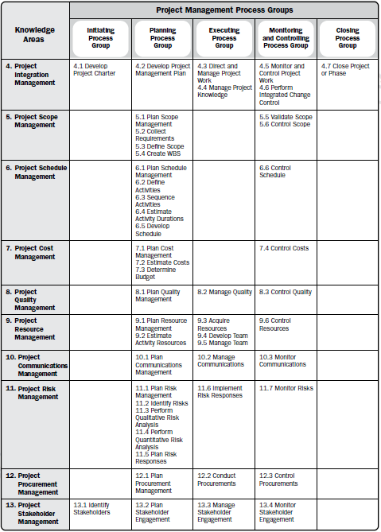
Project Management ProcessES IN PMBOK
(Diagram on page 25 of PMBOK 6th ed.)
Different types of project management practices are known as processes
49 PMBOK processes are organized into 10 knowledge areas (rows) and 5 process groups (columns)
Notes:
Note: Disregard the numbers 4 through 13 along the left edge of the table (they refer to Chapter numbers in the 6th edition of the PMBOK guide).

Slide 10
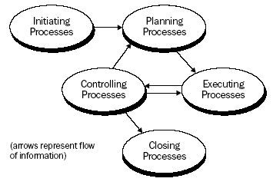
Project Management Process Groups: processes are also categorized by stage of a project’s life cycle

Slide 11
Knowledge Areas
The 49 project management processes in PMBOK are organized into 10 different subject topics, or “knowledge areas”
Integration Management
Scope Management
Time Management
Cost Management
Quality Management
Human Resources (HR) Management
Communications Management
Risk Management
Procurement Management
Project Stakeholder Management
In this course, we will explore 3 Integration Management processes and 6 Scope Management processes
Notes:
Source: PMBOK Guide, 6th edition

Slide 12

PMBOK inputs, tools & Techniques, outputs (ITTOs)
In PMBOK, each process includes a description of the process and ITTOs
Inputs: “Ingredients” (e.g., documents, raw data) that are needed to complete the process
Tools & Techniques: How the inputs are used
Outputs: What is produced, or the result of the process (e.g., planning document, budget, schedule)
Note: You will need to memorize process ITTOs for the mid-term test and final exam in this course (and also for the PMI certification exams, if you wish to become professionally certified)!
Notes:
Image Source: PMBOK Guide, 6th edition, page 22

Slide 13


BUT WAIT! BACK UP A STEP! Before we begin to manage a project, we need to understand… How are projects started ? …THEY START WITH AN IDEA

Slide 14
A PROJECT IDEA ON PAPER: THE Statement of Work (SOW)
Narrative description of the work to be completed if/when the project is launched
One or two page document (may be longer)
Created by senior management or project sponsor
This is where the initial ideas for a project are put on paper – the project hasn’t started yet!
SOW is reviewed and approved, and then the formal project is launched

Slide 15
Statement of Work (SOW)
Includes:
Strategic plan
Business need
Description of product or service (scope description)
May also include:
Funding constraints
High-level schedule (start, end and milestones)
Deliverables
Acceptance criteria
Etc.
To open this template on most computers, go into slide edit mode and double-click on the template.
Note: In different industries and workplaces, this document may be given a different name and may contain somewhat different components.
Notes:
Strategic plan: how does this project support the overall organization.?

Slide 16

The Project Charter
A document that formally authorizes a project (or phase)
It establishes a partnership between the performing organization and requesting organization
The requesting organization is the client
The client may be external to your organization (a customer) or internal (e.g., the Vice President of Information Technology may authorize a project to be undertaken by the IT department)
Formally initiates the project
Assigns a Project Manager (who is typically involved in creating the Charter)

Slide 17
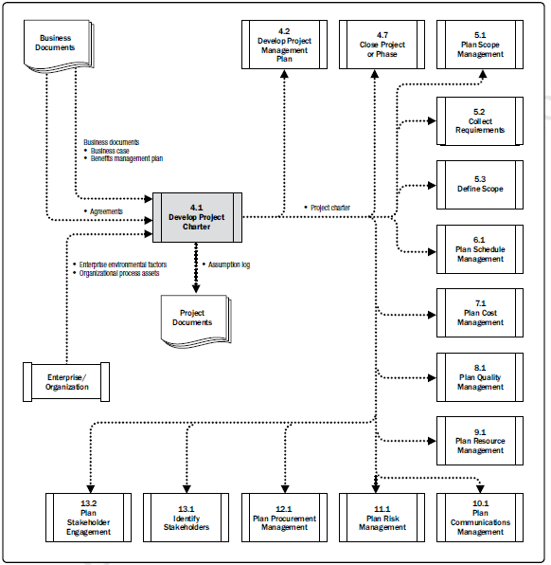
The Project Charter: An input to other PMBOK Processes
Note: See page 76 of PMBOK Guide (6th ed.) for an explanation of this diagram. It is an alternate way to see how the Develop Project Charter process influences other processes. Students are not required to reproduce or memorize these flow diagrams for the mid-term or final exam in this course.
Notes:
Source: PMBOK Guide®, 6th edition (page 76). See page 76 of PMBOK Guide (6th edition) for explanation of this diagram. It is an alternate way to see how this process influences other processes. Students are not required to reproduce or memorize these flow diagrams for the mid-term or final exam in this course.

Slide 18
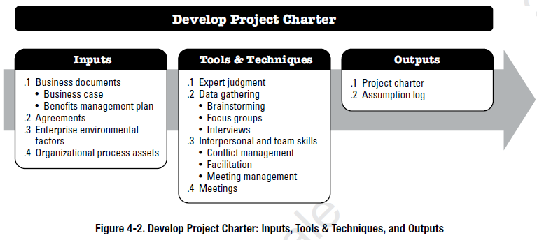
Develop Project Charter Process
Note: You will NOT need to memorize detailed ITTO diagrams (such as the one above) for the mid-term test and final exam in this course. But! You WILL need to memorize some inputs, tools, and techniques for each process: they will be highlighted in BLUE FONT in the PowerPoint slides.
Notes:
Image Source: PMBOK Guide, 6th edition, page 75

Slide 19
Develop Project Charter - InputS
Business Documents
Business case may include: business justification for the project, feasibility analysis, needs assessment, situation analysis, cost-benefit analysis
Examples of business needs: market demand, organizational need, customer request, technological advance, legal requirement, etc.
Benefits management plan: how and when the project benefits (outcomes of value to stakeholders) will be delivered
Agreements
Examples include Memorandums of Understanding, letters of intent, other written agreements, etc.
EF
Notes:
Source: PMBOK Guide, 6th edition
Example of a Benefits Management Plan template: https://www.praxisframework.org/files/benefits-management-plan-annotated.docx
Another Example of a BMP template: https://www.google.com/url?sa=t&rct=j&q=&esrc=s&source=web&cd=14&cad=rja&uact=8&ved=0ahUKEwivhMT0jZPaAhUvgK0KHfrAAcUQFgilATAN&url=https%3A%2F%2Fwww.aci.health.nsw.gov.au%2Fie%2Fprojects%2Fbenefits-realisation-guide%2Fguide%2FBenefits_management_plan.docx&usg=AOvVaw1GoFJZ0jQApivXlm4UEA_m
Other descriptions of BMP: https://project-management-knowledge.com/definitions/b/benefits-management-plan/

Slide 20

Develop Project Charter - Inputs
Organization process assets (OPAs)
Organizational processes and procedures for conducting project work (e.g., templates, policies, procedures)
Organizational knowledge stored in databases and historical files (e.g., past project files, cost databases)
Enterprise environmental factors (EEFs)
Conditions that constrain or influence the project success such as organizational structure, market conditions, industry characteristics/ environment, political climate, project management software or information systems, government/industry standards or requirements
OPA
EEF
Notes:
Source: PMBOK Guide, 6th edition

Slide 21
REMINDER TO STUDENTS!
IMPORTANT!
For the mid-term and final exams in this course:
You will NOT need to memorize every input, tool & technique, and output (ITTO) for the processes we learn in each module.
But!
You WILL need to memorize some ITTOs for the exams - they will be highlighted in BLUE FONT in the PowerPoint slides.
If an ITTO is NOT highlighted in BLUE FONT in the course PowerPoint slides, then you are NOT required to memorize it when studying for the mid-term or final exam.

Slide 22
Develop Project Charter – T&T’s
Expert Judgement
Data Gathering
Brainstorming, focus groups, interviews, etc.
Interpersonal and Team Skills
Conflict management, facilitation, meeting management, etc.
Meetings
Notes:
Source: PMBOK Guide, 6th edition

Slide 23
Develop Project Charter - OUTPUTS
Project Charter
Assumption Log
(in PPT SLIDE editOR mode, double-click to open or right-click to save)
Note! The Project Charter template in this PPT file will be used for the first assignment in this course (as directed in the assignment instructions). However, there are many different variations of these templates on the internet. In your organization they may have a different format or include somewhat different sections.
Notes:
Source: PMBOK Guide, 6th edition (output list)
Templates are not from PMBOK/PMI
Assumption Log Template is free from www.projectmanagementdocs.com

Slide 24


Document flow
Project Charter (the official authorization for the project)
SOW (the idea for the project)

Slide 25

The project is initiated
And away we go……

